Slide 1
An Unsupervised Analysis of the Sleep Health and Lifestyle Dataset
Del Gaudio Kevin
Iseni Angelica

Slide 2
Does the data organise itself into groups, without ever seeing the diagnosis?
Most existing work trains a model to predict a diagnosis from fixed features. This project takes a different route: the Sleep Disorder label is withheld from every clustering algorithm until the very end
If groups emerge on their own, do they relate to a diagnosis the algorithm never saw?
Demographics, behaviour, physiology, sleep metrics only are seen by Clustering
374 synthetic records, 13 attributes
(Kaggle Sleep Health & Lifestyle Dataset)
Sleep Disorder label held out till evaluation for Clustering, but kept as a node in the Bayesian Net
None Insomnia Sleep Apnea

Slide 3
From a messy synthetic table to 21 clean features
Encoding
Redundant Variables & Outliers
Scaling
Blood Pressure string → Systolic / Diastolic
Occupation (11 levels) → one-hot
BMI Category → ordinal
Sleep Disorder NaNs → explicit “None” (MNAR)
Necessity to preserve 0/1 one-hot columns as-is and to keep features comparable for Euclidean distance
1. Diastolic dropped: ρ = 1.0 with Systolic
2. Grubbs (univariate) ∩ LOF (multivariate)
3. Only 2 points confirmed by both: removed
MinMaxScaler
372 of 374 observations kept

Slide 4
Ten configurations, judged on what they agree and disagree about
3 clustering methods
Model-selection criteria
Hierarchical (Complete & Ward linkage)
K-Means (random & k-means++ init, 50 restarts)
DBSCAN (density-based, flags noise)
Internal: silhouette s(i) tracked with WSS/BSS
External (post-hoc only): ARI, V-measure, purity vs. the withheld label
Structural Constraints
Applied at final selection, after both rankings are built, not during scoring
× 2 feature spaces
Coverage constraint: DBSCAN scores only on assigned points, not comparable if points are left as noise
Balance constraint: reject silhouette gains from near-singleton clusters
Full 22-dimensional space
PCA-reduced, 8 components (≥ 90% variance)

Slide 5
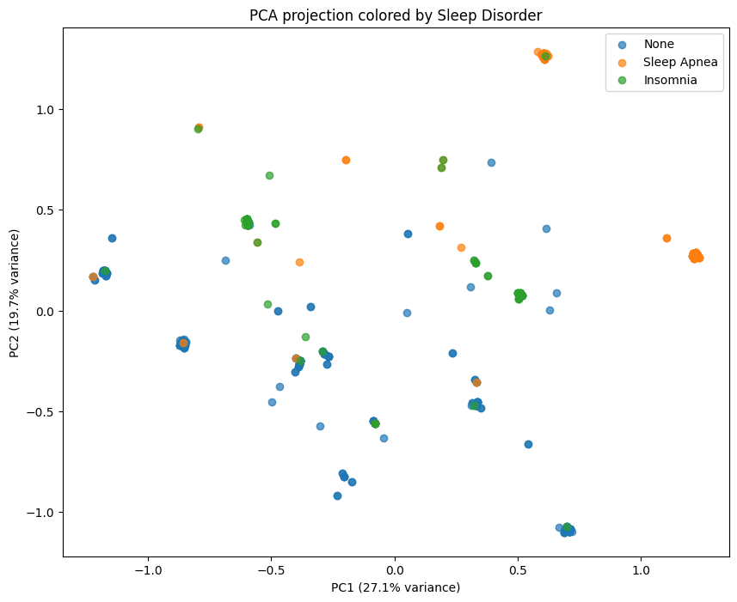
A non trivial result: the diagnostic classes overlap
What the projection shows
First two components capture only 46.8% of total variance (27.1% + 19.7%)
None, Insomnia and Sleep Apnea overlap heavily rather than forming clean regions
This is expected and important: were the classes cleanly separated, clustering would merely reproduce the labels
Fig. 1: PCA projection of the full feature space, coloured by Sleep Disorder.

Slide 6
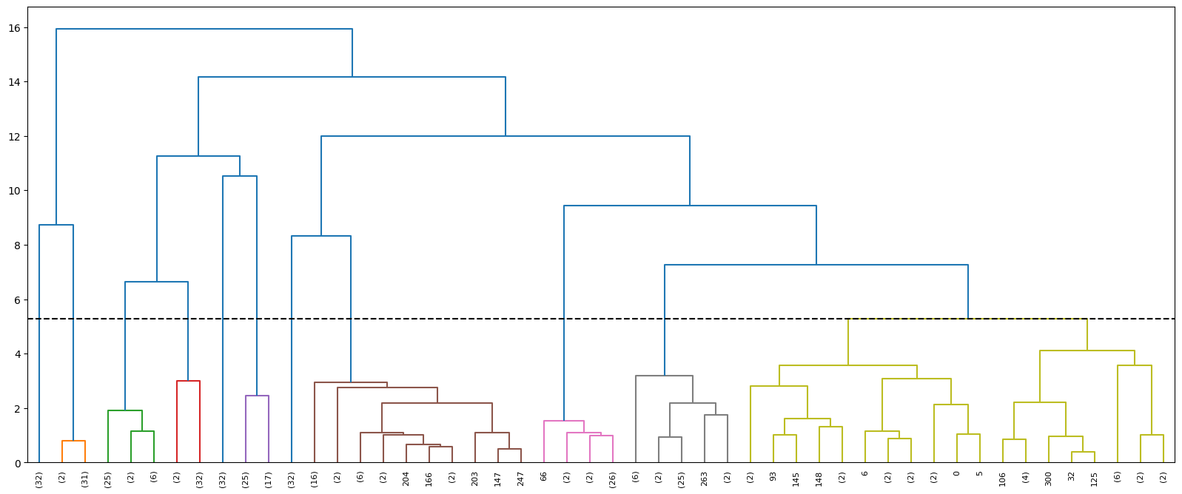
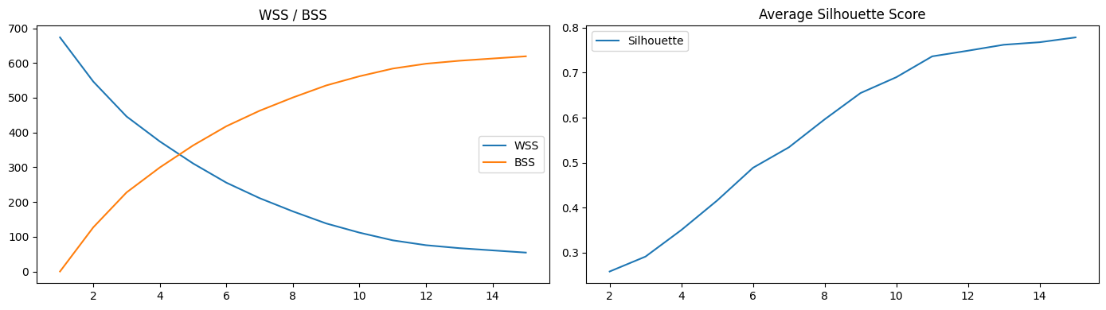
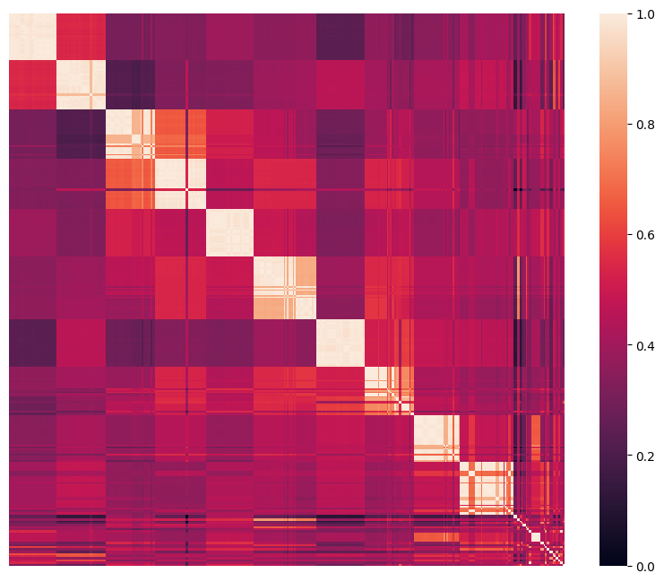
Choosing Ward on PCA: the highest external score isn't the winner
Fig. 3: WSS/BSS and silhouette across k = 1–15 (Ward, full space)
Fig. 2: Ward dendrogram, cut at k = 11. Balanced branches, no fragmentation
Why not the configuration with the top external score?
Ward–PCA leads internally (silhouette 0.770) with clean, balanced clusters
Complete linkage (PCA) has the highest external score (ARI 0.224) but the worst internal geometry of any full-coverage method (silhouette 0.59); DBSCAN (ARI 0.183) scores second-best but leaves 21% of subjects as noise
Ward is the best trade-off , not the top single number on either ranking
Fig. 4: Sorted similarity matrix (Ward, k=11): clean diagonal blocks

Slide 7
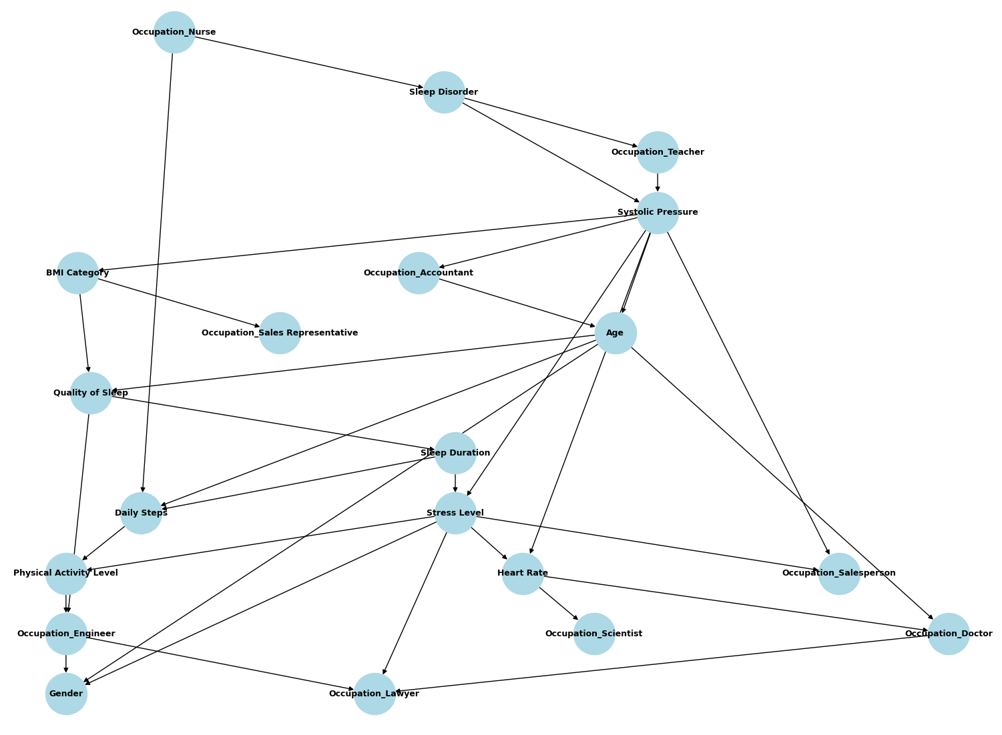
Bayesian Network: A physiological chain emerges
Hill Climbing
An edge survives only if its gain outweighs its complexity cost
34 of 462 possible edges retained; only 2 occupation columns end up isolated
What structure emerged?
Systolic Pressure, Stress Level and Age emerge as hubs
A coherent physiological chain: BMI Category → Quality of Sleep → Sleep Duration → Stress Level → Heart Rate
Sleep Disorder is peripheral: just 1 parent (Occupation_Nurse) and 2 children (Occupation_Teacher, Systolic Pressure)
Fig. 5: DAG learned by Hill Climbing (BIC score): 34 edges, 2 isolated nodes

Slide 8
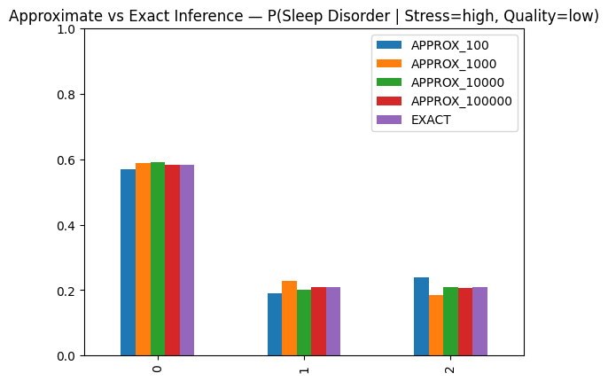
The Markov blanket alone doesn't tell the whole story
The blanket is small
MB(Sleep Disorder) = the same 3 neighbours from before: Occupation_Nurse, Systolic Pressure, Occupation_Teacher
Neither Stress Level nor Quality of Sleep belongs to it
Is the exact computation itself reliable?
But exact inference disagrees
Stress=high, Quality=low → None 58% · Apnea 21% · Insomnia 21%
Stress=low, Quality=high → None 46% · Apnea 37% · Insomnia 18%
The blanket only guarantees independence once the WHOLE blanket is observed
The open path: Sleep Disorder → Systolic Pressure → Stress Level , unblocked, since Systolic isn't observed
Fig. 6: Approximate (10²–10⁵ samples) vs. exact inference for P(Sleep Disorder | Stress=high, Quality=low). Bars 0/1/2 = None/Apnea/Insomnia.

Slide 9
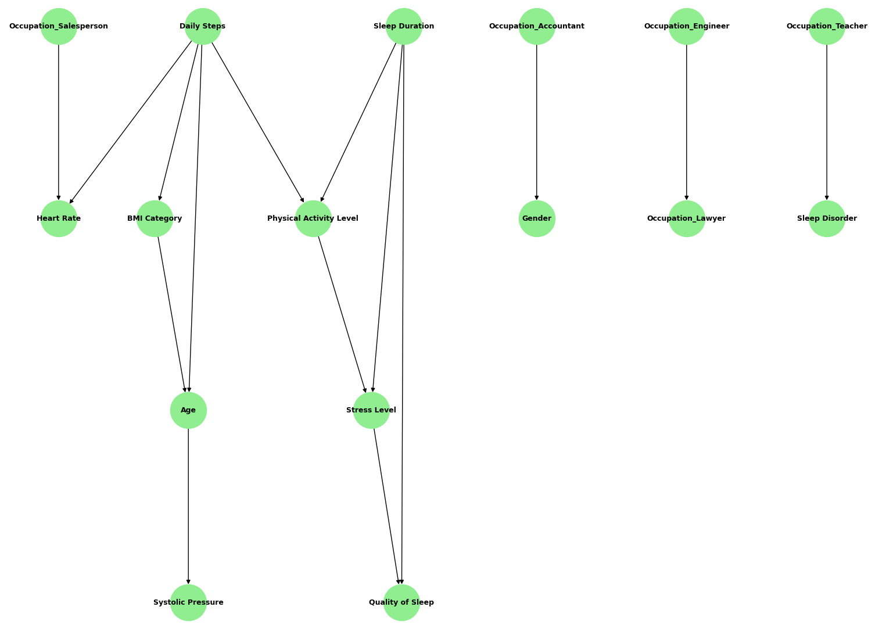
Bayesian Network: how much of this structure is Hill Climbing's own artefact?
PC is far more conservative
Hill Climbing starts from an empty graph and adds an edge if it improves the score;
PC starts from a fully connected graph and removes an edge unless a χ² test proves it's needed;
Only 3 edges agree, direction included
Daily Steps → Physical Activity Level
Occupation_Engineer → Occupation_Lawyer
Sleep Duration → Stress Level
The edges around Sleep Disorder are a hypothesis suggested only by Hill Climbing
Fig. 7 : DAG learned by the PC algorithm (χ² tests, α = 0.05): 15 edges, 6 isolated nodes.

Slide 10
Conclusions
Clustering
Agreement with Sleep Disorder is well above chance (Ward–PCA: ARI 0.14), recovered without ever seeing the label
Bayesian Network
BMI → Sleep Quality → Duration → Stress → Heart Rate; diagnosis is linked only indirectly. Agreement with a stricter test (PC) is weak
Future work
Validate on real clinical data; inject domain knowledge (e.g. root nodes); combine cluster labels into the network as an added variable
Limitations: the dataset is synthetic; no method fully recovered the three diagnostic categories

Slide 11
Thank you for your attention!

